Slide 1
Destination Branding and the role of story telling
Wausi Walya

Slide 2
Destination Branding
A Country brand is important in securing prosperity, it determines the perception of trade partners, tourists ,investors ,other sovereign states ,donors , media (a key influencer ) among others
A strong destination brand = ability to exert influence over its international reputation

Slide 3
Definition - components
Destination brand identity includes identifying the principal element that compose it – including culture, character ,personality, name , logos , slogan
There has to be consistent brand elements and management of these elements that allow all destination brand stakeholders to portray the brand cohesively
How do we position the unique selling points ?

Slide 4
Managing a destination brand cannot entirely be achieved through communication although this may be used to raise awareness s of what a country is known for – e.g. music, art , sports, tourism attractions , products and other services
Many players are involved in building a destination brand – e.g. government , civil society , promotion agencies , investors etc. thus the need for liaison in fronting a positive destination brand
Notes:
All opportunities that avail a country a chance to showcase itself are aimed at building its image /reputation

Slide 5
Africa Image
Reputation for being poor, corrupt , disease ridden, unsafe , uncultured, backward – implication on areas economic, social , political growth
There has to be a deliberate effort to enhance brand credibility , need to live up to the brand
The more powerful a brand is ,the less the investment in promotions , believability is key
Prosperity and good governance associated with the general success of a destination brand

Slide 6
Africa s story
Africa has many options to tell her story
What is on our news headlines ?
What does our leadership project about our destination brands ?
Is Africa on negotiation tables fronting her strengths , any leads in innovation ?
How does Africa leverage on her potential in recent interest by other continents to invest in the continent?

Slide 7
Key benefits of destination branding
Attracting factories and companies
Attracting tourists
Seeking new market opportunities
Managing the image**
Improved economy
Good governance , security , reduced poverty , control of resources , democracy = strong destination brand

Slide 8
Story – telling
Innovative ways to keep the destination brand positive , maintain reputation
Communication cannot be left to the traditional ways
Tourism e.g. is competitive - need to differentiate oneself - how does a country tell its story in a compelling way

Slide 9
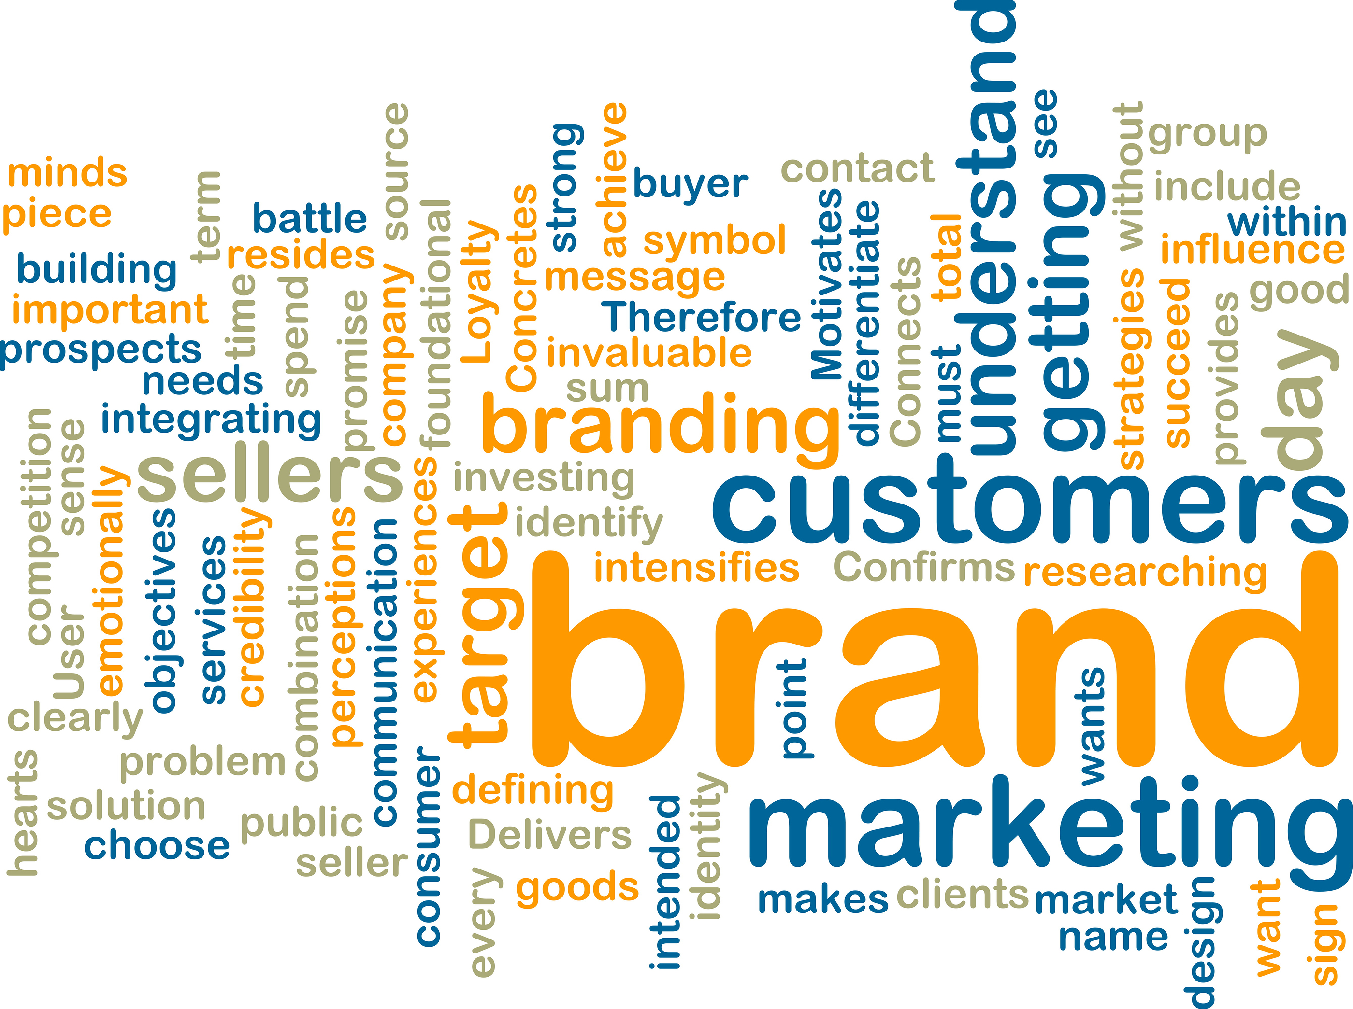
What is in a destination Brand ?(UNWTO– 2009 )

Slide 10
Intel plant - bid (1996)
In 1996, Intel Corporation’s worldwide site location team was asked to make a recommendation about where the company should place its first plant in Latin America. Numerous countries competed to be the recipient of the $300–500 million investment, money that would bring in new jobs, taxes, complementary industries and new exports (100 per cent of the production would be exported to the USA)
The high level of technical education in the country and the number of electronics firms already located there the smallest of the four finalists – form clusters of excellence , a country with only 3.5 million people, ended up winning the Intel plant. The country was not even on the original shortlist.
Costa Rica won because it used many of the principles of place marketing.

Slide 11
Destination branding - enhanced tourism
Travel has fast become one of the most shared stories in this realm as it is rich in both experience and visual content- and tools such as check-ins and tags have further enriched this.
With tourism as a key economic anchor for may countries , the is a lot of investment in promoting destinations
More credible story telling techniques to attract visitors are key – authenticity plays a key role

Slide 12
Digital space
On online platforms have gradually evolved into user defined channels-
Websites have become tools for accessing resources and information
Twitter - a tool for accessing news content – US President
Instagram - means of sharing moments in an immediate visual manner.

Slide 13
Online channels for story telling
Facebook has become an autobiographical tool used predominantly by Generation X as they approach middle age
It is a means of sharing experiences in an engaging way that lends itself to telling self-penned stories of our lives- driven by family, social activity and experience

Slide 14
You Tube
YouTube has become the world’s largest media platform and video has become a logical tool for storytellers- visual, powerful and transcendent of language.
A notable trend in recent years has been the rising acceptance of long form video online, with users who once lost interest after a few minutes now becoming accustomed (due to the popularity of digital networks such as Netflix) to watching full long form programming online and on devices.

Slide 15
Online platforms - Strength
Online platforms are a powerful tool in the travel space for both travelers and destinations
Stories that show the effect of travel on an individual and the positive change it brought to them are the most powerful- and this aligns to Christopher Bookers theory of the 7 Basic Plots- including ‘The Quest’, ‘The Journey and Return’ and “Redemption and Rebirth’.
By telling a story from a travelers perspective a destination can also target market segments by creating stories about that particular demographic
Stories such as these give the destination a human face and create an emotional connection to travel.

Slide 16
Crete Tourism targets single female travelers with a compelling story about one such traveler
(load actual clip)
https://www.youtube.com/watch?v=5D4dC6sFvSQ

Slide 17
South African Tourism reaches out to regional African travelers with a fable like story
< https://www.youtube.com/watch?v=tH_rjHT1-W0

Slide 18
KLM Airlines which creates an emotional connection to their Lost Property services:
https://www.youtube.com/watch?v=NK-T_t166TY >

Slide 19
Authentic versions
Stories have come to serve multiple services, even for managing negative reputational issues for destinations.
Unbranded video (based on an actual tourist experience) used to show how misunderstandings fuel negative perceptions, as part of their award winning and controversial ‘I hate Thailand Campaign’:
https://www.youtube.com/watch?v=54uzEouACYs >

Slide 20
Advantages of story telling
The stories are a form of advertising but they connect very effectively with the audiences
Aggregating and Managing actual user generated content from travelers via social media and use legitimate story telling by real travelers to create engaging and powerful destination messaging is the new trend

Slide 21
American family visiting Kenya tell their story directly from their own perspective:
https://www.youtube.com/watch?v=RgSO9UALDOc&t=123s

Slide 22
Story telling – the future
How does story telling influence what the stakeholders /DMOs and policy makers portray a destination brand vis a vis what the tourist perceive ?
The how , the authenticity - so do influencers have a role or do we get real travelers to tell our stories or do we stick to the traditional media as PR Practioners to enhance the strength of our destination brands
We must integrate all aspects to survive the current competition for the over 1 billion travelers rolling the world’s economy through tourism

Slide 23
Quick wins
A SWOT Analysis ,identify strong areas e.g. landmarks , services, industries – USPs that form a strong case for strong branding and story telling
What ‘big idea ‘ communicates all these - consistently
Target large impact through compelling campaigns – entrench story telling to enhance credibility of the destination brand
Ensure all stakeholders deliver the promise in the ‘destination story’ .

Slide 24
Select References
Destination Branding: Creating the Unique Destination Proposition Nigel Morgan and Annette Pritchard University of Wales Institute, Cardiff Roger Pride Wales Tourist Board Second edition Copyright © 2002, 2004, Elsevier Ltd. Linacre House, Jordan Hill, Oxford OX2 8DP
Marcello Risitano, Business Studies PhD, Research Fellow at Marketing Laboratory: The role of destination branding in the tourism stakeholders system. The Campi Flegrei case 1
KELLER, K.L. (2003b), Strategic Brand Management. Building, Measurement and Managing Brand - Equity , 2° ed., Pratice Hall, New Jersey.
KAPFERER, J.N. (2004) Strategic The New Strategic Brand Management. Creating and Sustaining - Brand Equity Long Term, 3° ed., Kogan Page, London
WTO (2000) Tourism market trends 2000: long-term prospects.
UNWTO handbook on destination Tourism Branding (2009)

